Slide 1
Breast Cancer Detection
by – Onkar Patil
26 Nov 2021

Slide 2
Summary
This presentation is to understand complete Data Science cycle for Classification problem using Deep Learning, here a breast cancer detection is analyzed.
In upcoming slides I am going to discuss about the steps that need to be followed, approaches and the result.
At the end, we will compare results obtained from two approaches
Lets begin…

Slide 3
Steps in Data Science Life Cycle
Data Collection + Pre-processing + Feature Engineering
Model Selection/Preparation + Training and Testing
Deploying best model and consuming (Using for actual production)

Slide 4
EDA – Data pre-processing & Feature Engineering
Here data we choose is from UCI repo - https://archive.ics.uci.edu/ml/machine-learning-databases/breast-cancer
It is well structured data, contains 9 categorical variables/features to detect breast cancer recurrent event. Data is unevenly distributed i.e 201 – class 1, 85 class 2. As Data is well structured only label encoder is used as all the features are categorical.
Note– There were 10 missing value entries, I dropped those rows

Slide 5
Approach
Approach 1: Use Deep Neural Network with proper activation functions. Try different combinations
Approach 2: Use famous TabNet architecture developed by Google Cloud AI. It targets mainly structured tabular data and thus suitable for our example

Slide 6
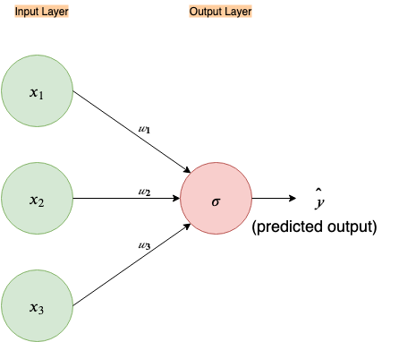
Approach 1: Use DNN
Single Neural Network with activation function like ‘sigmoid’ or ‘tanh’ make it simple logistic regression architecture and become our base line performance.
We can consider it as our base model.
Adding hidden layers and nodes makes it ensemble of simple linear regression. Helps to improve the performance

Slide 7
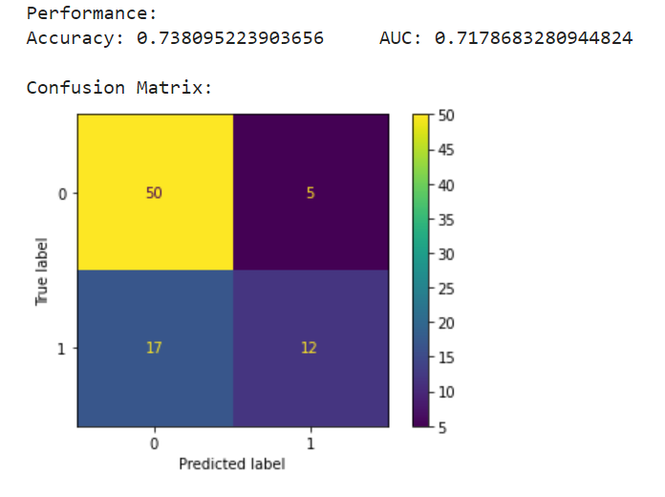
Performance from Single NN
This result shows our guess was right and we can expect Deep Neural Network will perform better than this

Slide 8
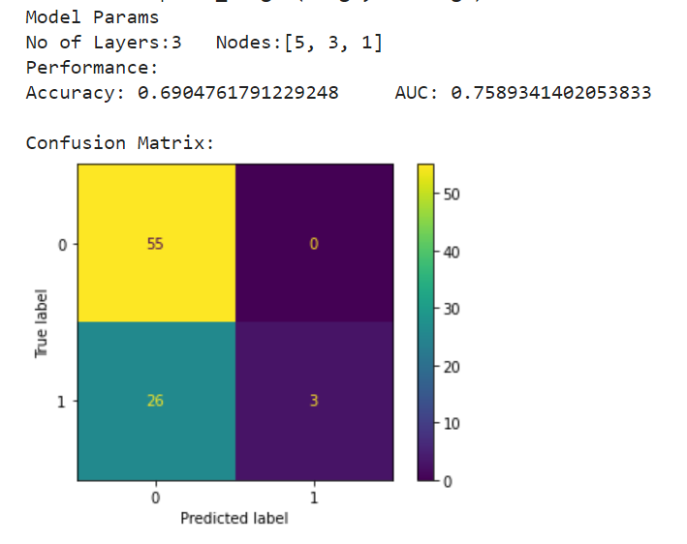
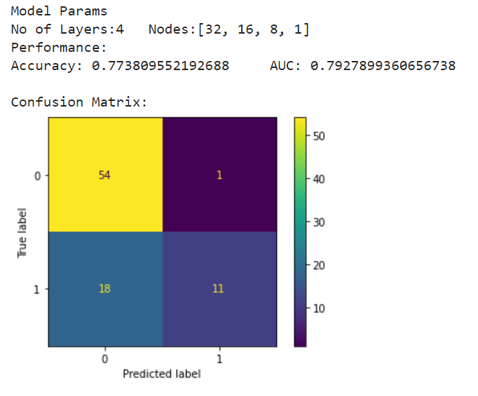
DNN: Check performances for different Layers , Nodes combination

Slide 9
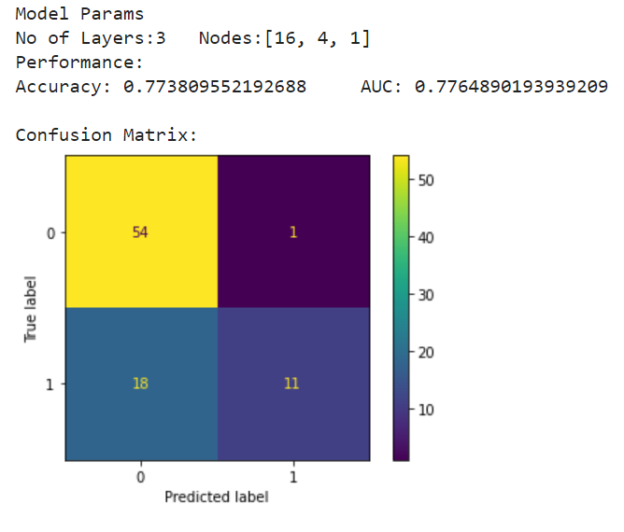
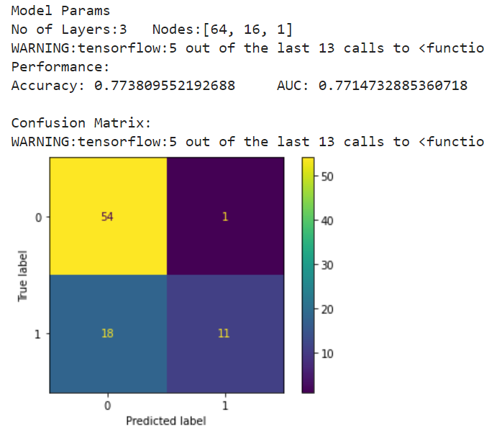
Best performance obtained at combination: No of Layers:4 Nodes:[32, 16, 8, 1]

Slide 10
Approach 2:TabNet
Architecture consists four parts:
Encoder
Decoder
Attentive Transformer
Feature Transformer
One of the coolest features of this network is the ability for the network to point out which features were used in it's final decision. And these features change from input to input. Random Forest doesn’t have this feature

Slide 11
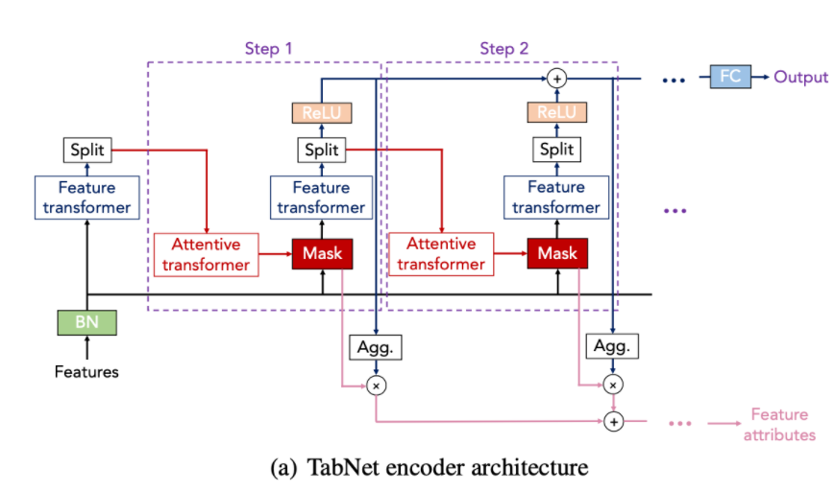
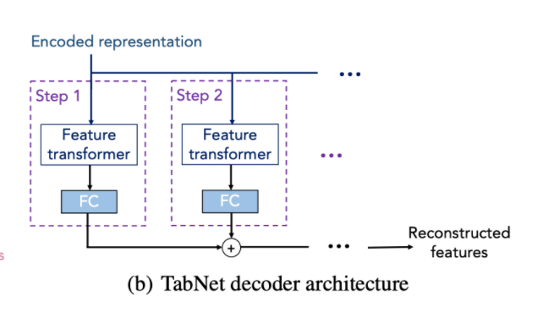
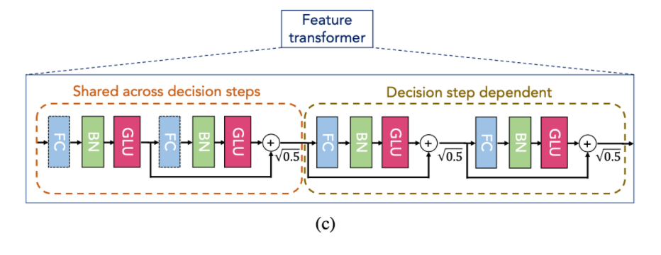
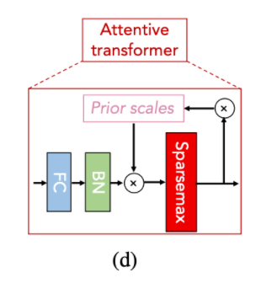
Model architecture

Slide 12
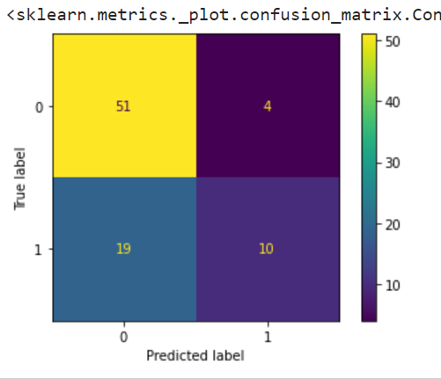
Result
Accuracy: 72.61
As size of dataset is not enough for this architecture to fully trained.

Slide 13
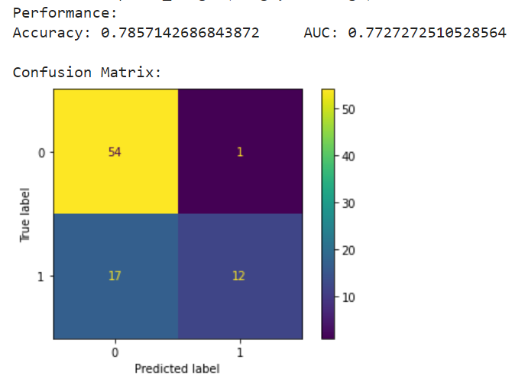
Comparing results from two approaches
Approach 1 : DNN
Accuracy: 78.57
Approach 2 : TabNet
Accuracy: 72.61
As Data was well structured and all the features were categorical so DNN with sigmoid activation function performed well. Where as TabNet lag behind due to insufficient data to fully train its weights

Slide 14
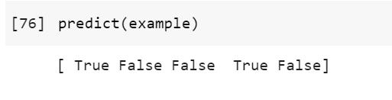
Consuming best model to predict future power consumption
Two out of 5 are having recurrent event

Slide 15
Thank you

